Slide 1
ESP32 with micro python

Slide 2
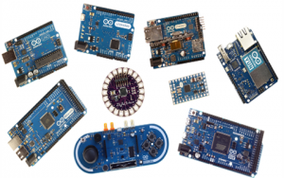
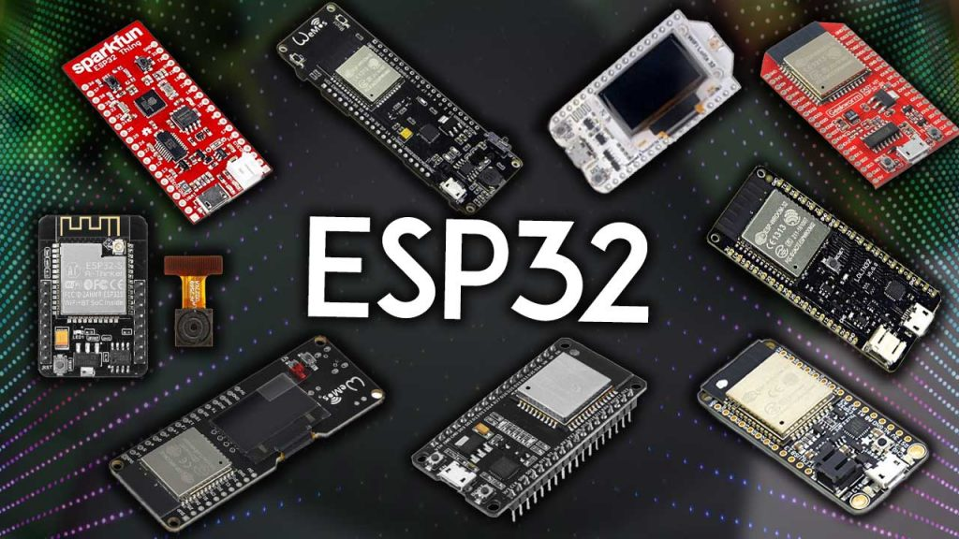
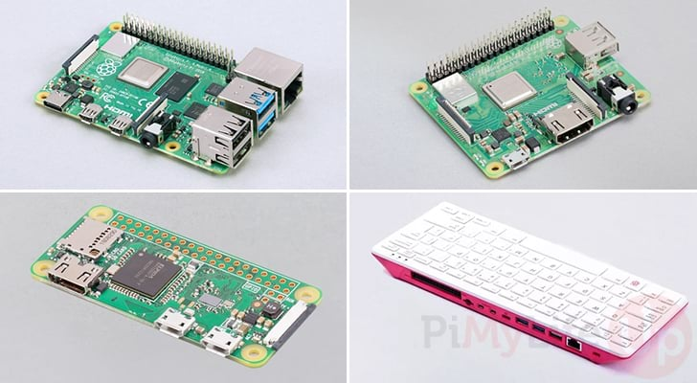
Arduino
ESP32
Raspberry pi

Slide 3
ESP32
Arduino env
Micro python env
Visual studio env
IDF RTOS

Slide 4
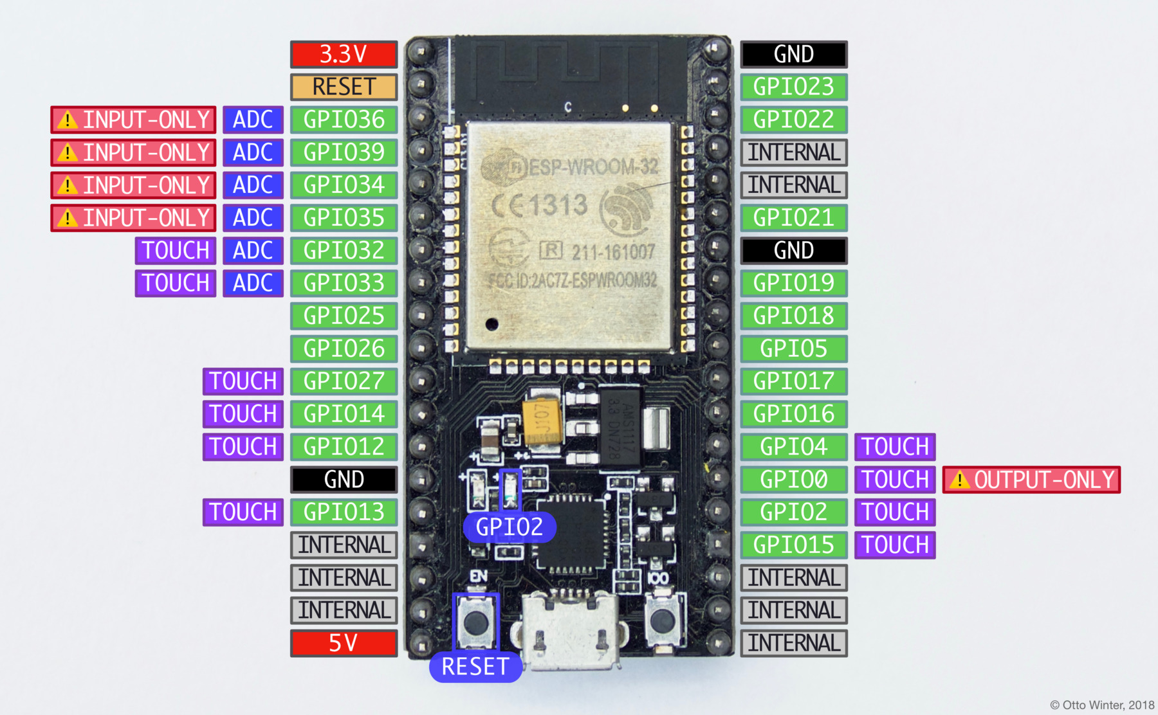

Slide 5
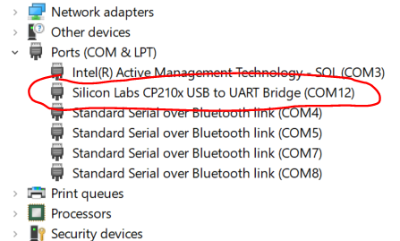
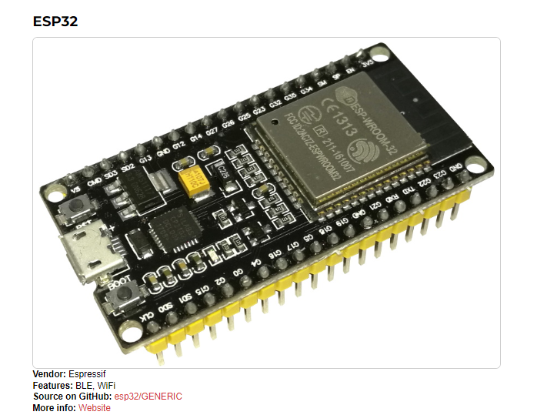
Get ready
Install ESP32 driver. CP210x
Recognized in device manager
Install Thonny
Download FW from micropython.org
Save .bin file
Clone my Git:
https://github.com/avisalmon/upython-esp32

Slide 6
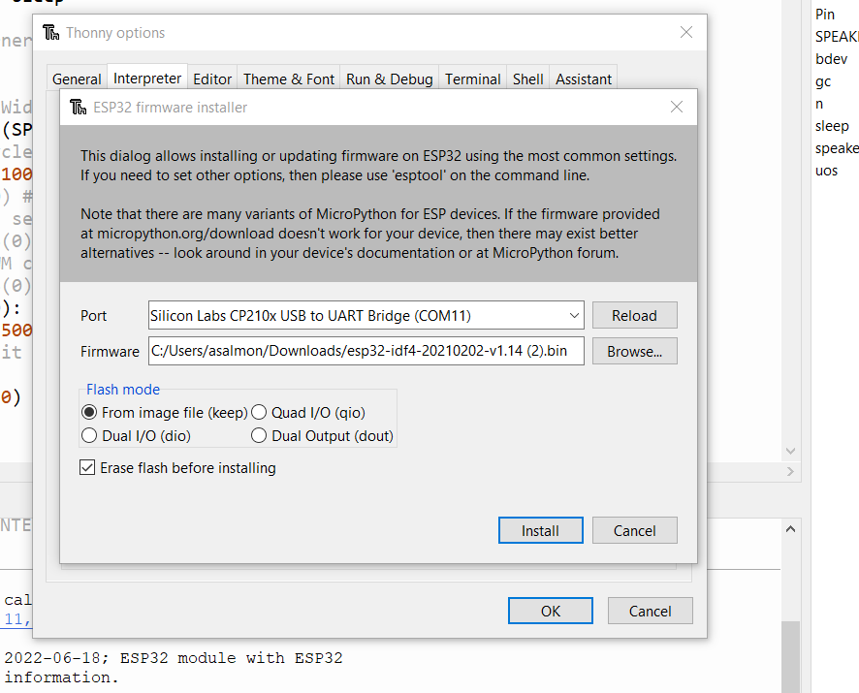
Get ready
In Thonny → tools → manage plug-ins
Look for esptool and install it. (Intel network blocks it)
Tools → options → interpreter → choose MicroPython (ESP32)
Install or update Micropython
Press boot button if not downloading
Your port
Bin file

Slide 7
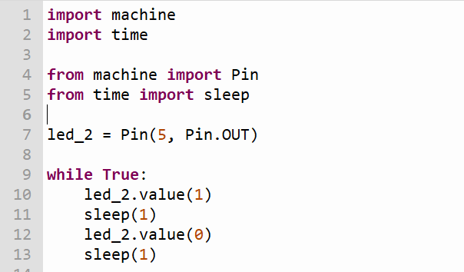
blink

Slide 8
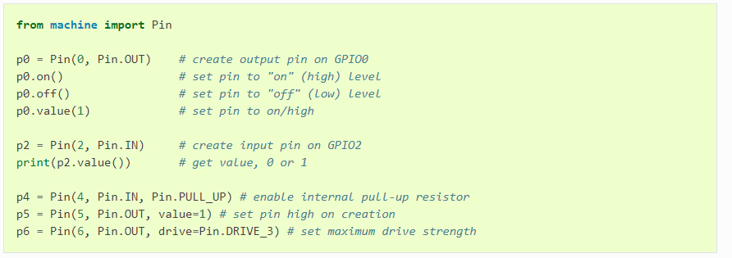
Digital IO

Slide 9
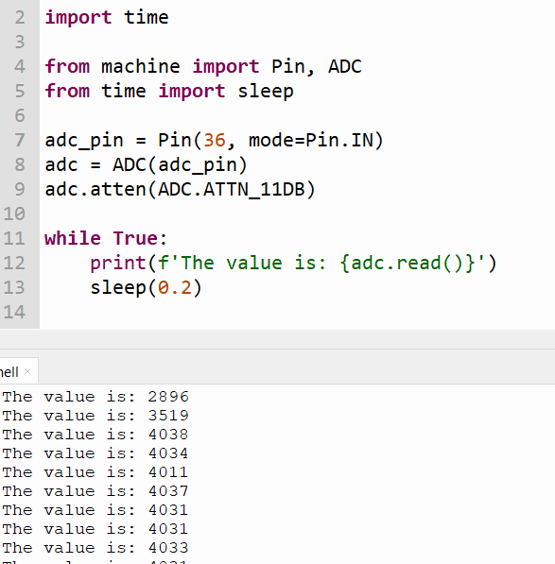

ADC read

Slide 10
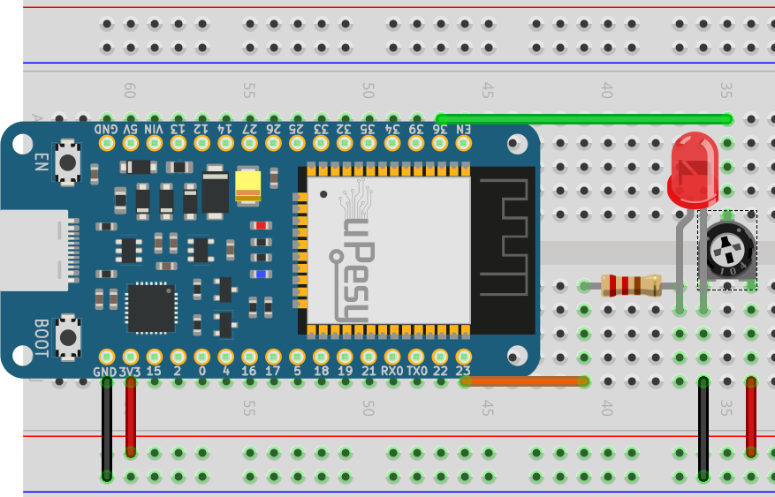
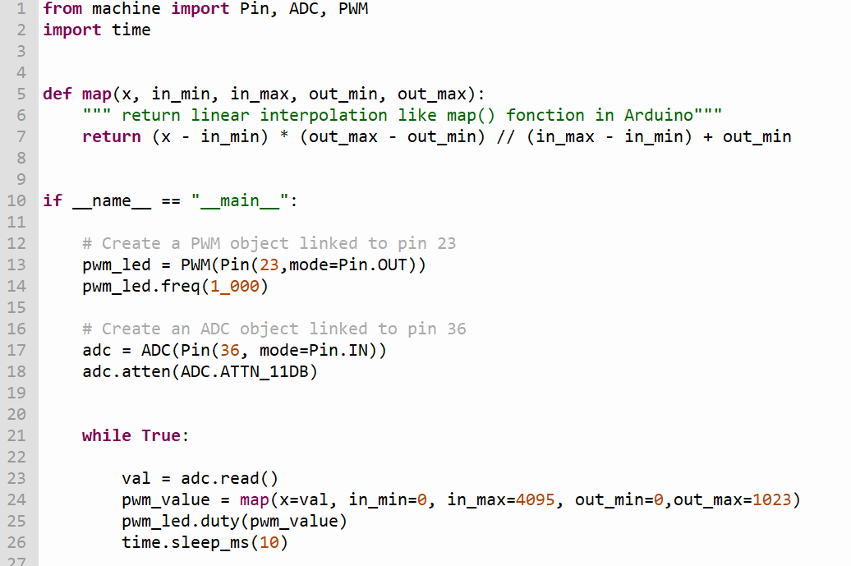
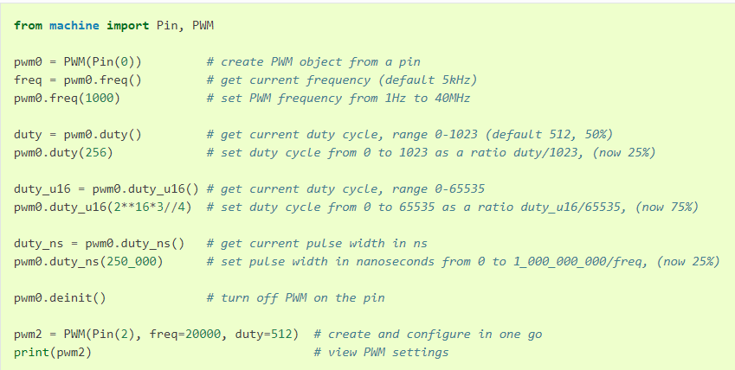
ADC Dimm

Slide 11
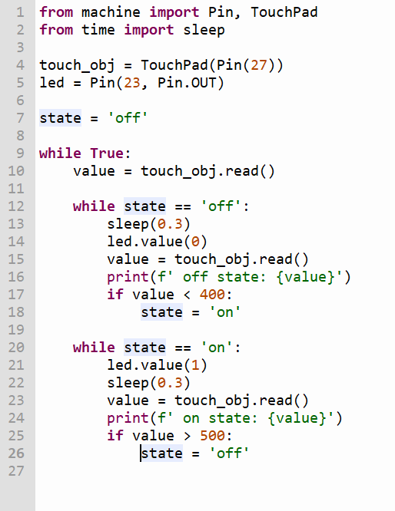
Touch

Slide 12
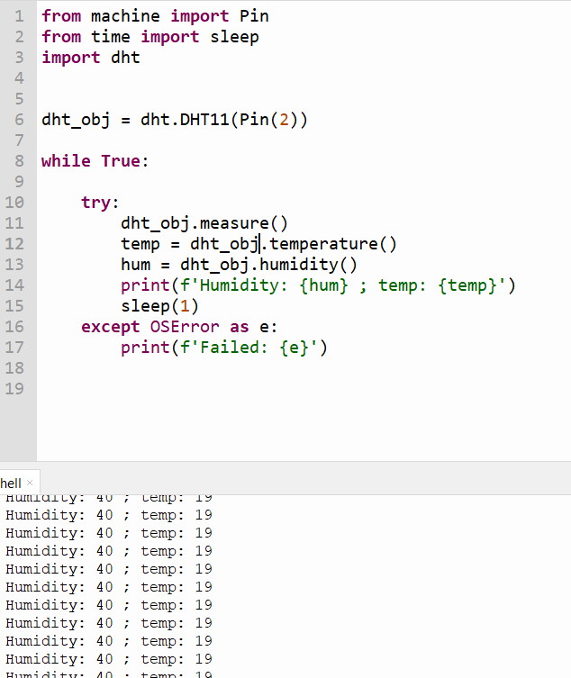
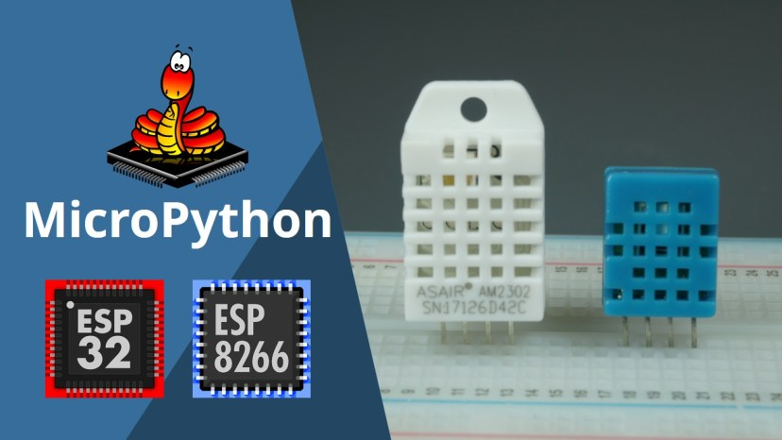
DH11

Slide 13
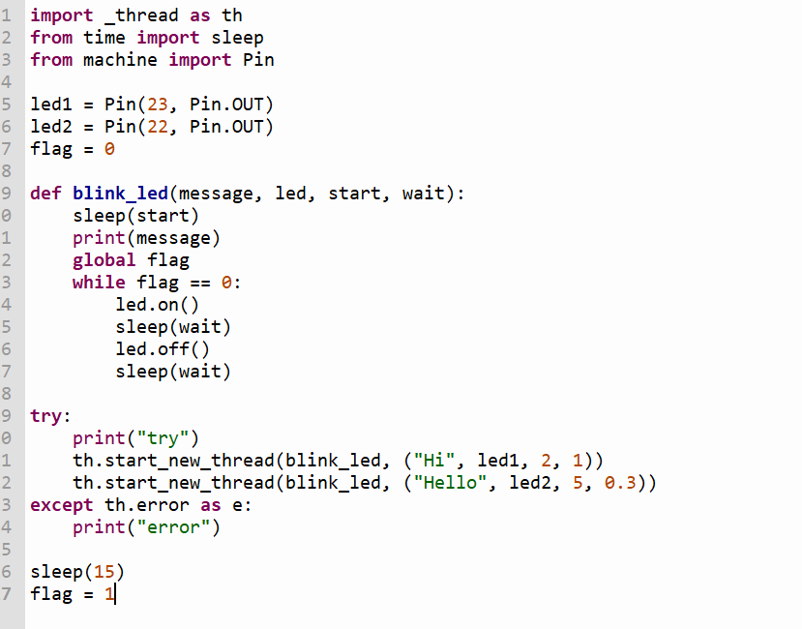
Threading

Slide 14
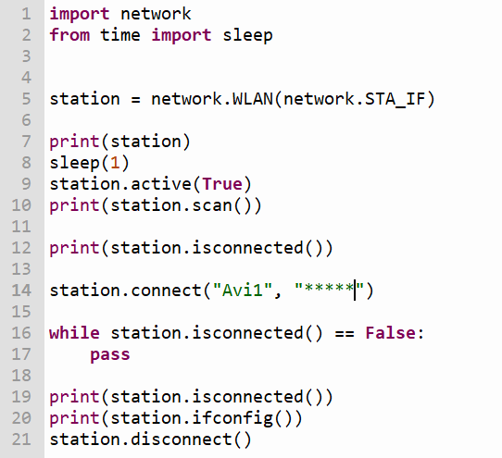
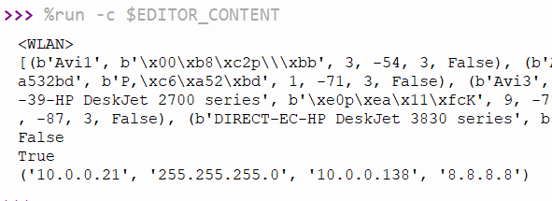
WLAN - scan

Slide 15
On Device
boot.py
main.py

Slide 16
Now you:
Connect to Touch
Connect to DH11
Build a Simon game.

Slide 17
API example – connect to weather
https://openweathermap.org/api
https://api.openweathermap.org/data/2.5/weather?lat=32.79&lon=34.98&appid={api}
help() → urequests
ujason

Slide 18
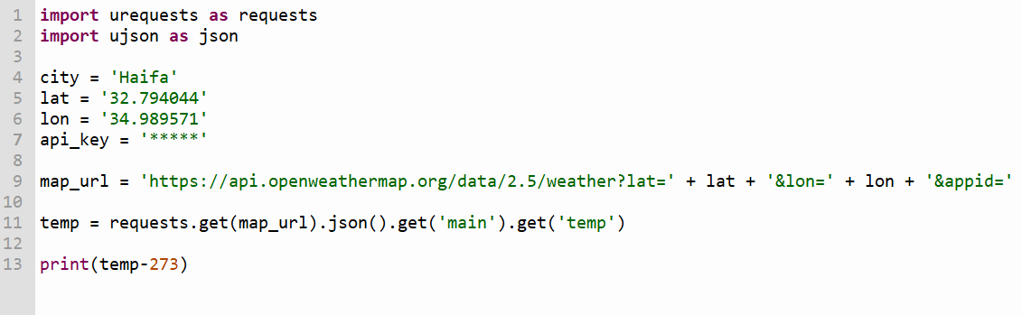
https://api.openweathermap.org/data/2.5/weather?lat={lat}&lon={lon}&appid={API key}

Slide 19
Where to look next
Google.
MQTT

Slide 20
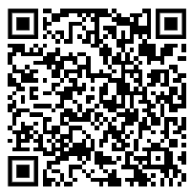
רוצים לשמור על קשר?

